Slide 1
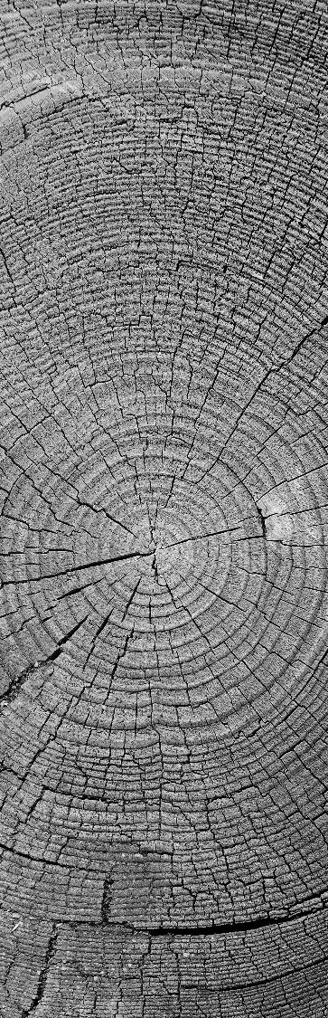

MECHANICAL LEG SUPPORT FOR NON-WEIGHT-BEARING ANKLE INJURIES
Final Year Project

Slide 2

OVERVIEW
Problem Statement
Objectives
Anatomy of the Ankle
Ankle Injuries
Gait Cycle
Limitations of Crutches
Design Consideration
Design and materials

Slide 3
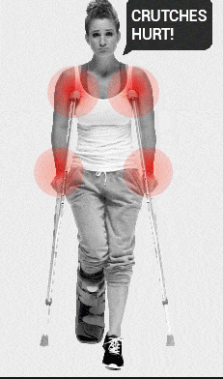
PROBLEM STATEMENT
Early weight bearing on severe injured ankles can pose more damage to the ankle resulting in re-injury.
Traditionally, crutches are temporal walking aids that are used.
It causes injuries to the upper limbs in particular, the shoulder, axilla and the wrist.
These crutches can also cause muscle atrophy of the injured leg due to the disuse of the affected leg over a long period of time.

Slide 4

OBJECTIVES
The focus of this project is to build a portable leg support for persons with non-weight bearing ankle injury to aid locomotion before and after medical treatment until they are fit to use their foot again.
This would also eliminate the effects that may be experienced on the upper limbs.
Specific Objectives
A support that will effectively bear the weight of the person but has to be light-weight.
Comfortability of the patient while using the device.
Energy storing and returning base to propel the person forward easily.

Slide 5
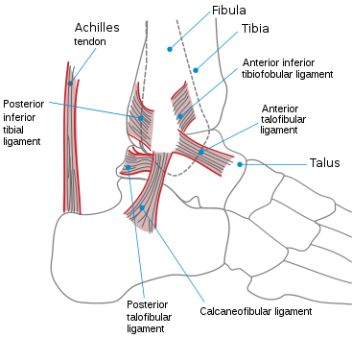
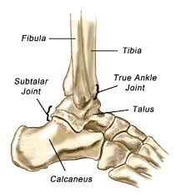
ANATOMY OF THE ANKLE
The ankle or the talocrural region is the region where
the foot and the leg meet.
Ankle Joint
It is a hinge type joint, permitting dorsiflexion and plantar flexion of the feet.
It is formed by three bones of the leg; Tibia,
fibula and talus.

Slide 6
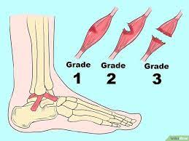
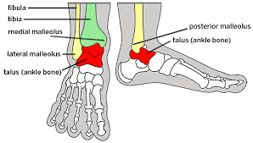
ANKLE INJURIES
Ankle Fracture: this is the break in one or more of the three bones in the ankle joint.
Ankle Sprain: most commonest. This is the damage to ligaments when they are stretched beyond normal range of motion. (0-50 degrees for plantar flexion and 0-20 degrees for dorsiflexion).
Ankle Strain: damage of muscles and tendons as a result of being pulled or stretched too far
Swelling
Bruising
Difficulty in walking
pain

Slide 7
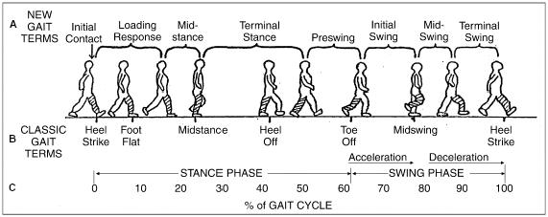
GAIT CYCLE
Two phases;
Stance phase- occupies 60% of the gait cycle, during which one leg and foot are bearing most or all of the body weight.
Swing phase- occurs 40% of the gait cycle during which the walking surface and the body weight is borne by the other leg and foot.

Slide 8
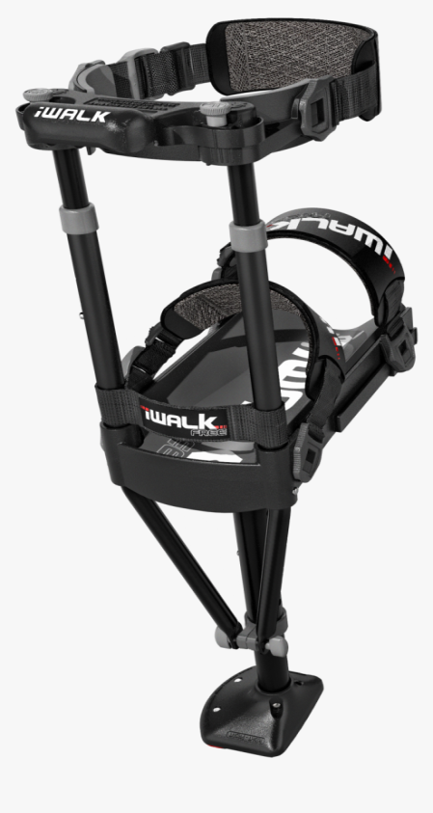
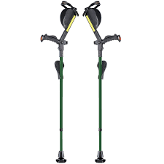
Existing solutions
Forearm Crutches
Axillary Crutches
Hands-Free Crutches

Slide 9
LIMITATIONS OF crutches
Crutches
In crutch walking, the tip of the crutches transmits forces directly to the hands, wrist and axilla.
Hand – 44% of body weight
Axilla- correct use-5% of body weight
incorrect use- 34% of body weight
Supporting leg- increase of 24.5% of ground reaction forces

Slide 10
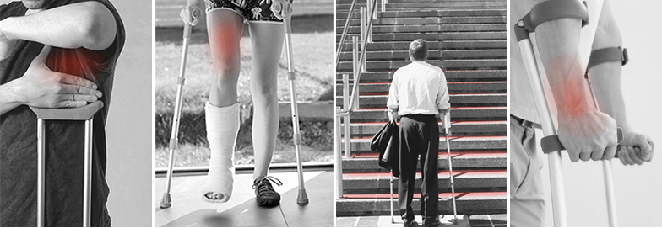
Limitations of crutches
Underarm and Wrist Injury
Bruised ribs or soreness- continuous pressure from the saddle of the crutch to your ribs.
Atrophy for the lower limb- using crutches makes the lower limb passive for weight bearing.
Radial Nerve- due to the over-compression of the radial nerve by the axillary pad.
Restricted use of hands for activities

Slide 11

HANDS-FREE CRUTCHES
Allow users to use their hands for other activities.
Enables the users to do more complex activities easily.
No bruise or blisters at the underarm
No soreness in hands.
Limitations o
Expensive- $100-$150 dollars
Bulky

Slide 12
DESIGN CONSIDERATION
The device has to be lightweight for easy mobility. It has to weigh about 2.5kg – 4kg.
The device has to be strong enough to bear. (tensile strength and compressive strength).
Longitudinal and transverse loading of a cortical bone
Tensile strength~130MPa and 50MPa respectively
Compressive strength~190MPa and 130MPa respectively
The device has to be telescopic. (height adjustment)
The base of the device has to be flexible enough to compress and also have the ability to store and return energy for propulsion.
Shear and fatigue loading will be considered in analysis

Slide 13
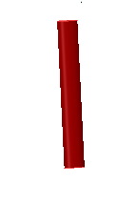
Design and materials
Components of Design
Shank
Due to the elimination of the leg, ankle and foot, the shank will mimic the human shank by bearing weight.
During double stance, the shank must share the body’s weight with the uninjured limb. I.e. each has to bear 50% of the body’s weight when and 100% of the body’s weight in single-stance.
The shank must have the capacity to bear that much weight without deforming.
The shank is telescopic, i.e. an adjustable height
The minimum and maximum height of the shank is 35.9cm – 97cm respectively.

Slide 14
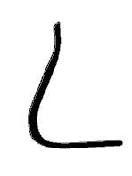
CONT’D
Base
The area of the base should be wide enough to reduce pressure that would be transmitted to the knee and thigh.
the base will serve as energy storing (shock absorption) and energy returning
(propulsion) to replicate normal ambulation.
The length of the base - 26.3cm
area of base- 100cm2.
The height of the curve 19.8 cm based on the height of the ankle clift to
the sole of the feet.
The radius of the curve is 4m based on the radius of the curvature of the foot.

Slide 15
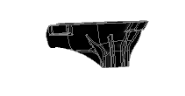
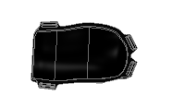
CONT’D
Leg/Knee Platform
The estimated width of the leg/knee platform was based on the average width of the human calf ;33cm-36cm (12.9inches-14.17inches).
the length of the leg/knee platform will be based on the moment that would occur around the knee.

Slide 16
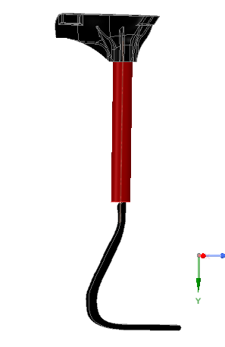
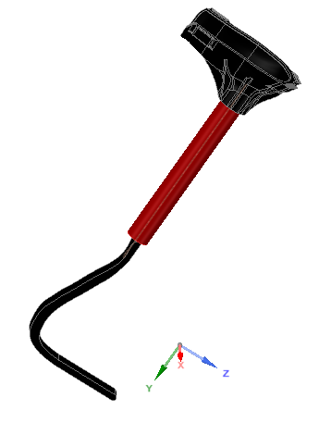
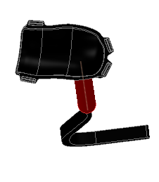
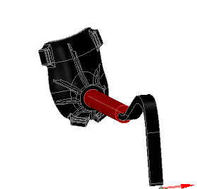
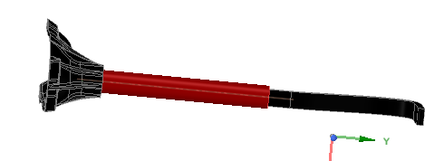

Slide 17

Materials Considered (Shank)
ALUMINUM
BAMBOO
Aluminum is very lightweight with a specific weight of 2.7g/cm³.
Aluminum is ductile (0.01)
Aluminum is 0.007mm thick, but it is still durable.
Aluminum has a typical tensile strength between 40MPa to 700MPa and Compressive Strength of 30MPa.
Flexural strength of about 210.3MPa
Bamboo is very lightweight with a density of about 0.66g/cm³
It has a compressive strength of 78.7MPa
Bamboo has a tensile strength of 206.2MPa.

Slide 18
Comparison between Aluminum and Bamboo
 | Bamboo | Aluminum
Tensile Strength | 206.2MPa | 40MPa to 700MPa
Compressive Strength | 78.7MPa | 30MPa
Specific density | 0.66g/cm³ | 2.7g/cm³
Flexural modulus/Young modulus | 13.1GPa | 70GPa
Although aluminum has some unique properties such shock-absorption, a large range of tensile strength, bamboo was considered. bamboo exhibits a higher compressive strength despite its lightweight and this is one of the key requirements of the design.

Slide 19
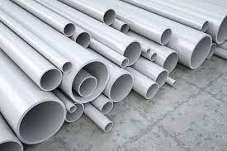
Materials cont’d
Leg/knee Platform
PVC-
A rigid platform to contain the knee and have a cushion in it for comfort.
PVC is very dense with specific gravity around 1.4
It ranks very well for hardness and durability
Compressive strength of 55MPa-89MPa
Tensile Strength – 34MPa – 62MPa

Slide 20
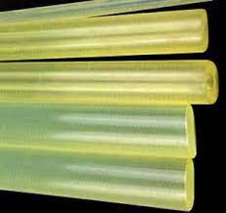
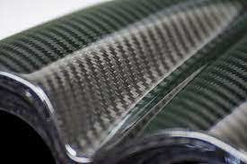
Comparison between CARBON FIBER and Polyurethane rubber
POLYURETHANE RUBBER
CARBON FIBER
It has a compressive strength and tensile strength of 90-250MPa and 18MPa respectively
It has increasing load-bearing capacity and tear resistance.
Polyurethane usually possess low stiffness
Due to its elastic properties, polyurethane is highly flexible and has shock-absorbing properties.
Carbon fibre has high tensile strength (3-7GPa), low weight and high stiffness.
It has good vibration damping.
It has a compressive strength of 1-3GPa
Carbon fibre is already in use for prostheses because of its elastic energy storage ability
Carbon fibre is naturally light and extremely flexible.

Slide 21
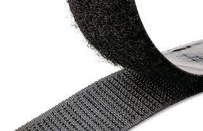
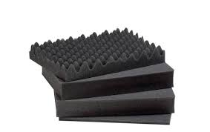
Fasteners:
Velcro
Velcro is one of the easiest and most common way of fastening things together
Relatively constant stiffness bond and large attachment strength.
Cushion:
Foam
Foam has an excellent weight bearing capacities and energy storing ability

Slide 22


